Slide 1

ACT-SYS-DT weekly update - 2

Slide 2
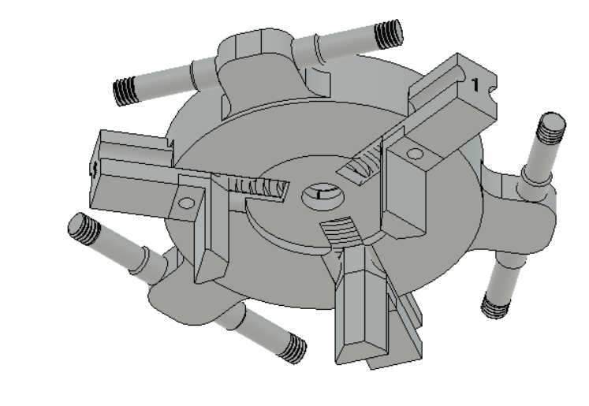
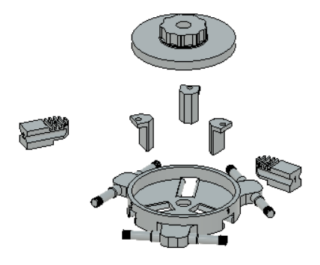
Revision of Work Holder
Max. Size of Transducer : 30mm
Clamping Force - Springs / Elastics / ?

Slide 3
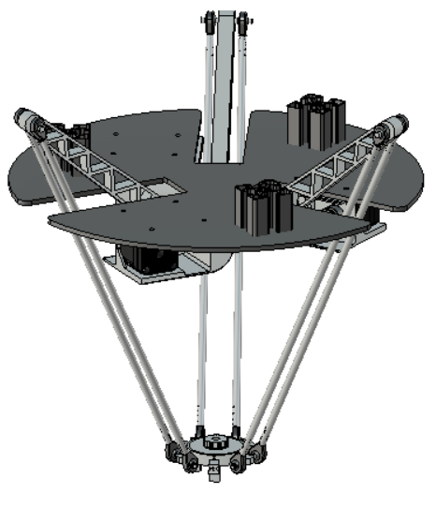
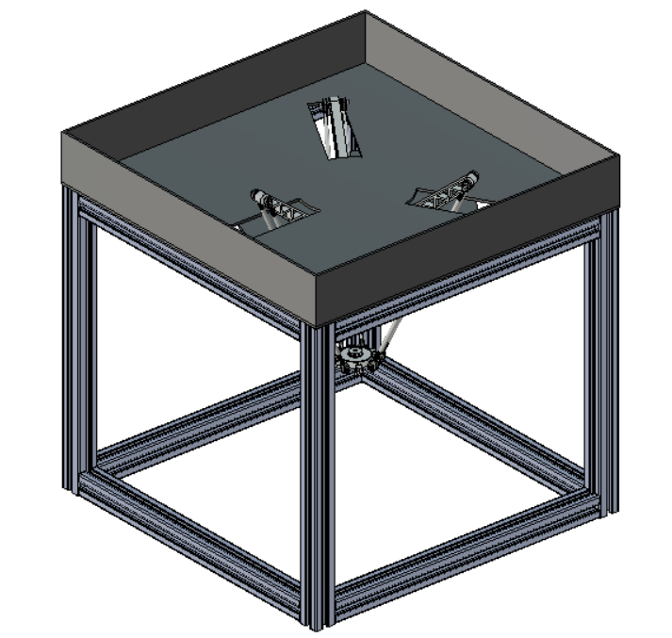
Assembly of Updated Parts

Slide 4
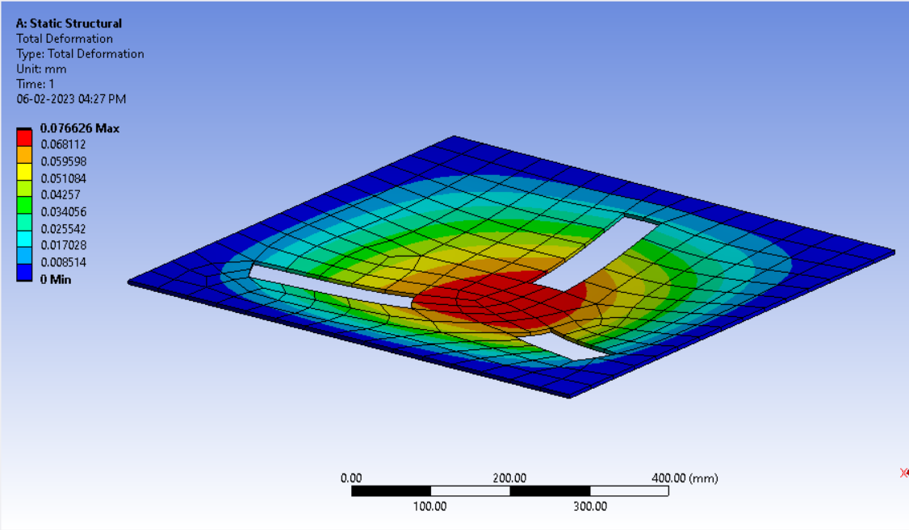
A Load of 50 N is applied at the Center
Result : the deflection at the center < 0.1mm. It is safe to use 5mm Al Plate

Slide 5
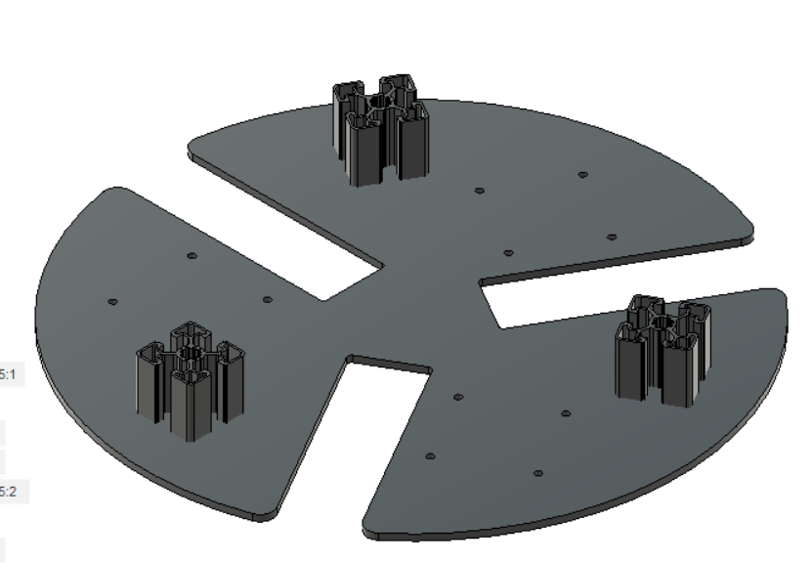
Mounting the robot with Enclosure
Aluminium extrusion of 45mm are placed on the base plate which allows the entire assembly to be mounted on the 5mm Al plate using L clamps.

Slide 6
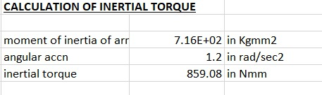
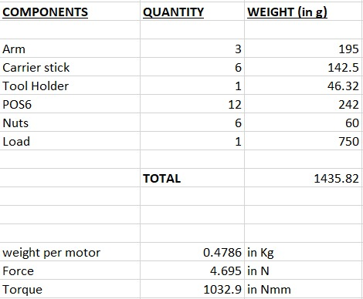
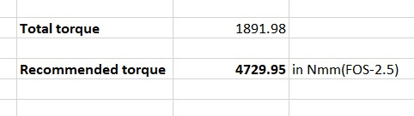
Updated torque calculation
τ total = τ load +τ inertia
= (859.08+1032.9)*2.5
= 4729.95 Nmm
Torque calculation was done considering all the components including the minor ones.
The effect of inertial torque was also considered in the selection of motor.

Slide 7
Derivation of Jacobian Matrix
Why Jacobian Matrix : This matrix relates the cartesian velocity (transducer holder velocity) to the Angular
velocity of the motors.
Jacobian Matrix is derieved from differentiating the position function.
(x -( l₁ + l₂cosθ-r) )² + y² + (z-l₂sinθ)² = R²
(x +0.5( l₁ + l₂cosψ-r) )² + (y+0.866( l₁ + l₂cosψ-r) )² + (z-l₂sinψ)² = R²
(x +0.5( l₁ + l₂cos∅-r) )² + (y-0.866( l₁ + l₂cos∅-r) )² + (z-l₂sin∅)² = R²

Slide 8
Differentiating Eqn 1 with time 2(x-(l₁+l₂cosθ -r ))(v_{x} + l2sinθ(dθ/dt)) + (2yv_{y}) + 2(z-l2sinθ)(v_{z} - l2cosθ(dθ/dt)) = 0 Differentiating Eqn 2 with time (x+0.5(l₁+l₂cosψ -r ))(v_{x} + l2sinψ(dψ/dt)) - 1.732(y+0.866( l₁ + l₂cosψ-r) )(v_{y}+l₂sinψ(dψ/dt)) + 2(z-l₂sinψ)(v_{z} - l₂cosψ(dψ/dt)) = 0 Differentiating Eqn 3 with time (x+0.5(l₁+l₂cos∅ -r ))(v_{x} + l2sin∅ (d∅/dt)) + 1.732(y-0.866( l₁ + l₂cos∅-r) )(v_{y}+l₂sin∅ (d∅/dt)) + 2(z-l₂sin∅)(v_{z} - l2cos∅ (d∅/dt)) = 0

Slide 9
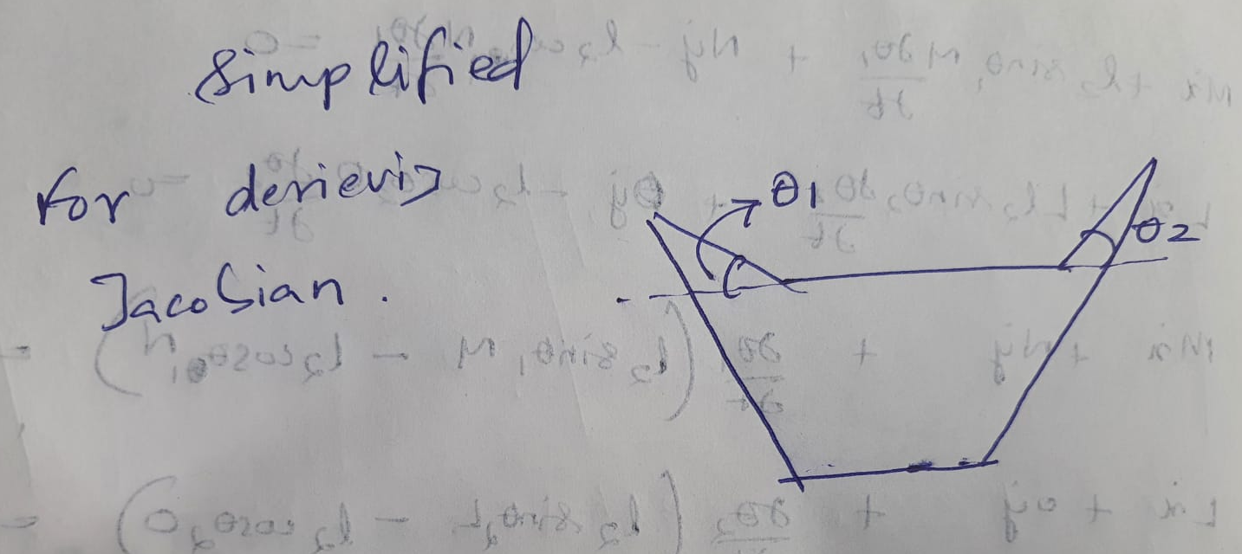
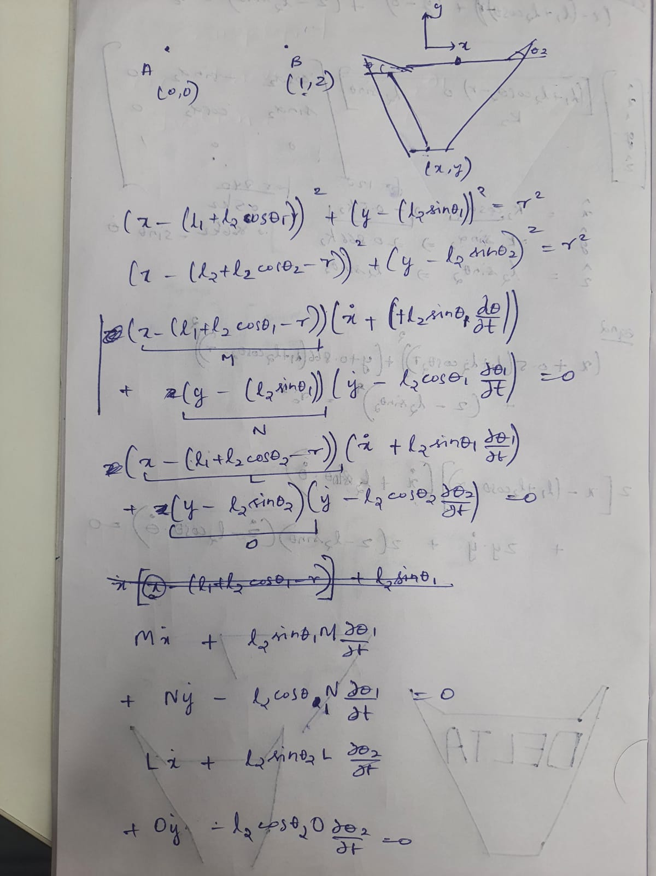
Simplified model for derivation of Jacobian matrix

Slide 10
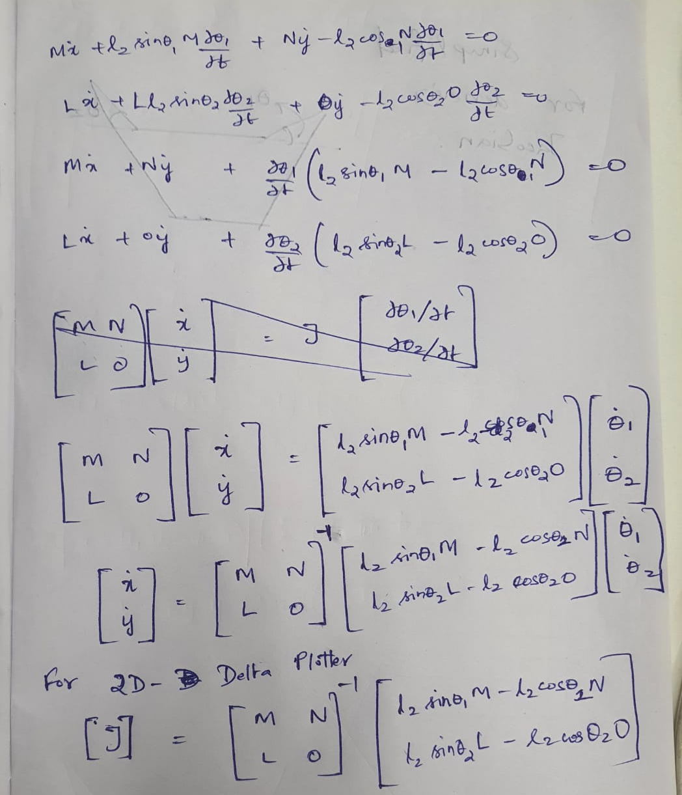
Simplified model for derivation of Jacobian matrix

